Slide 1
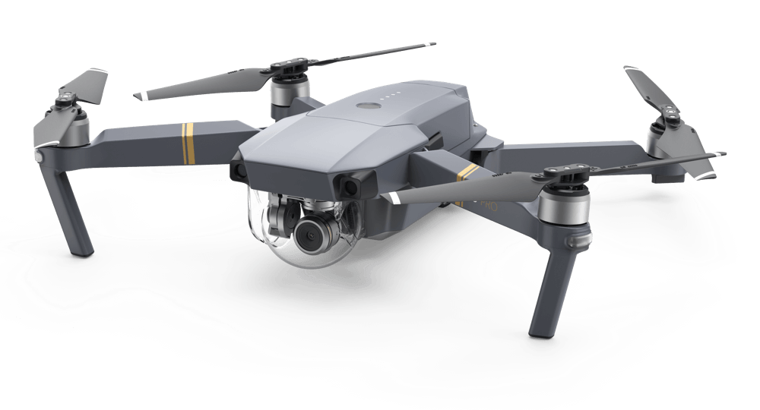
Performing Data Science on UAV Registries
Austin Derbique (Undergraduate)
12/14/2017

Slide 2
Drones - What about them?
Small unmanned aerial vehicles
Sales of electronic quadcopters have skyrocketed
More than double sales in just over a year ($200 million)
Over 2,000 new registrations a day in the United States

Slide 3
What is this data? Where can I find it?
n# | serial# | name | street | city | state | zip | Mfr name | Year mfr | Model name | Cert issue date | AC weight | type
102MN | AA102MN | UTAH STATE UNIVERSITY | 4120 OLD MAIN HILL | LOGAN | UT | 84322 | AGGIEAIR USU | 2014 | MINION | 03/17/2015 | UAV up to 55 | Government
Openly Available. Searchable by all fields. Available on FAA’s Website:
http://registry.faa.gov/aircraftinquiry/Aircraft_Inquiry.aspx

Slide 4
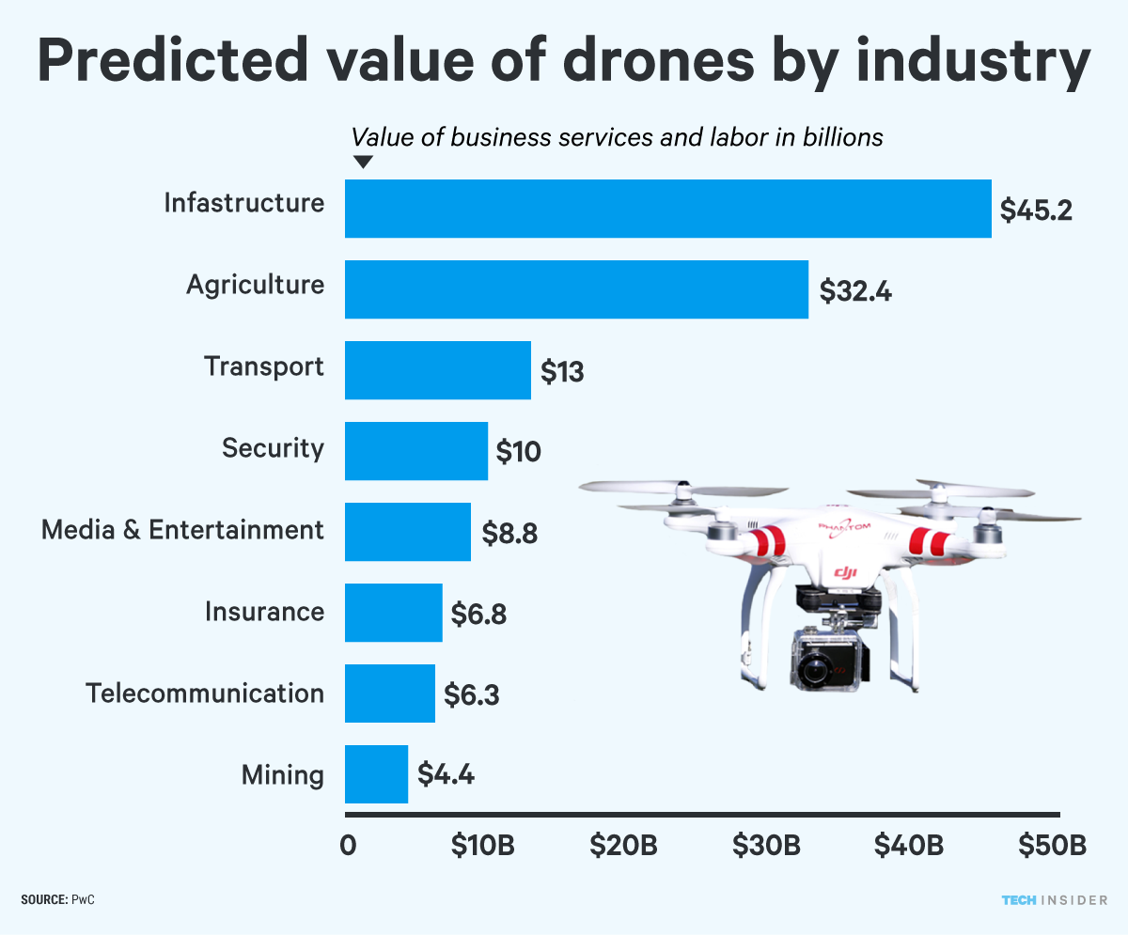
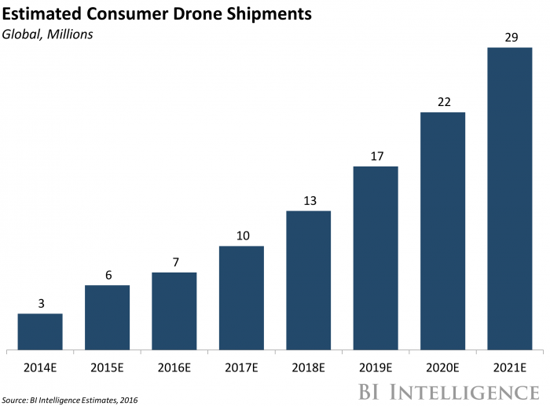
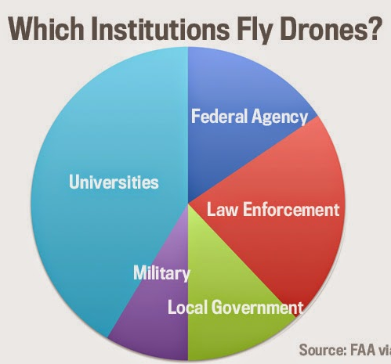
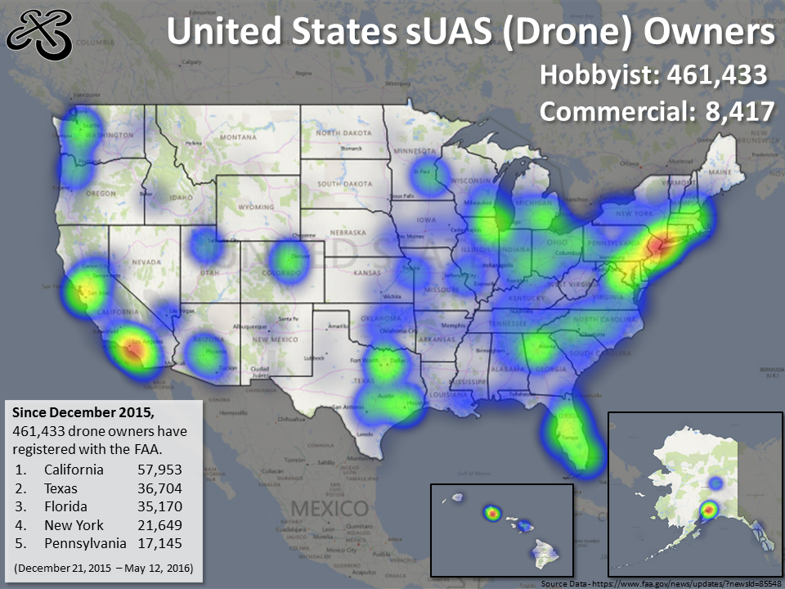
Possible Extractions From Data
Linear Regression
Logistic Regression
Standard Deviations
Other DS Techniques
Drone ownership over time
Who uses them and what for?
Where drone owners live
Predictions of how big the industry will continue to grow
Best selling models
Average price points for consumer
Drone price relative to socioeconomic location of purchase

Slide 5
References
http://www.timesreporter.com/news/20160918/t-r-special-report-popularity-of-drones-regulations-on-rise-550k-unmanned-aircraft-registered-with-faa
https://www.drone-world.com/media/wysiwyg/MavicPro/size_1000_540_a34ab5c95915a83b150d5157c21ae613_TJ.png
Google Images for the graphs

